Slide 1
20 Time Project -
Learning to Make Games in Unity
Leon Shainski

Slide 2
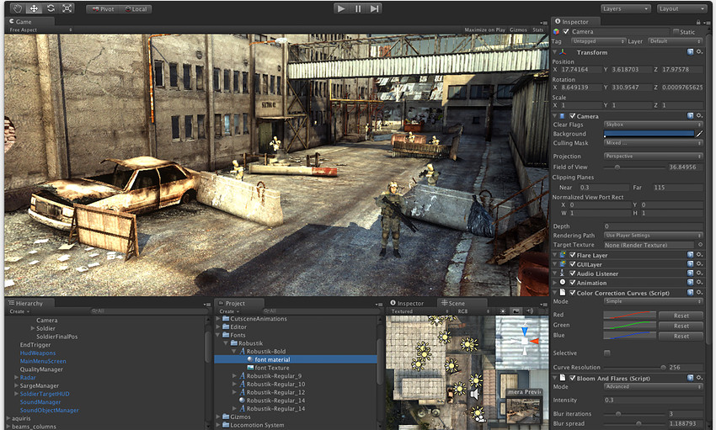

Objective
To learn how to use the Unity engine/platform
The unity engine uses C#, so the secondary objective is learning some C#

Slide 3
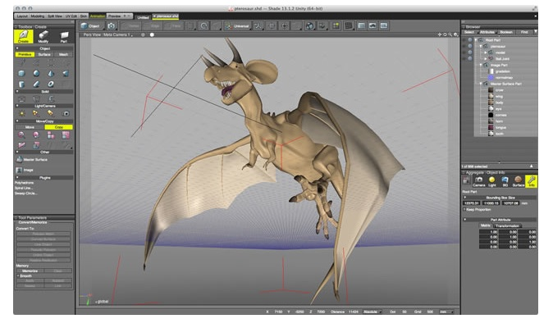
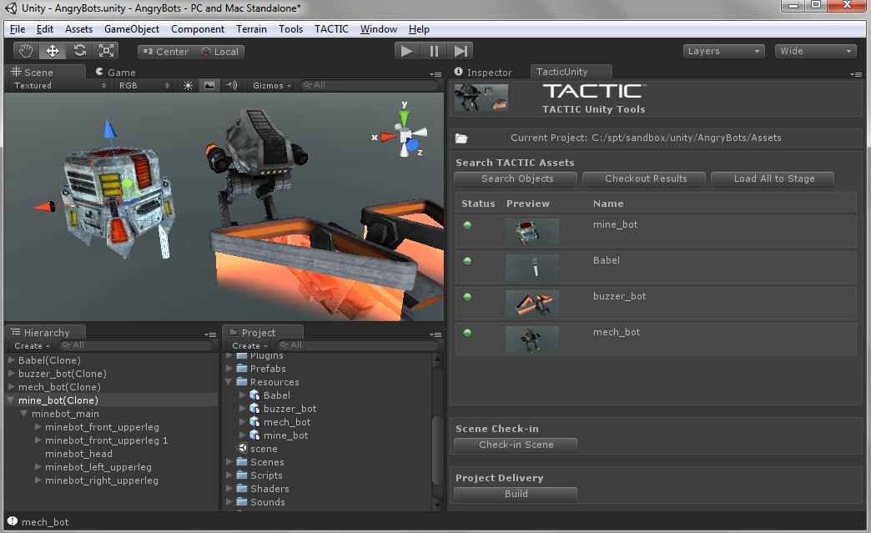
Objective
The Unity is a platform for making games
It uses C# code
It is a visual platform to make games, great for starters, and allows for learning game making basics
Great start into 3D game making

Slide 4
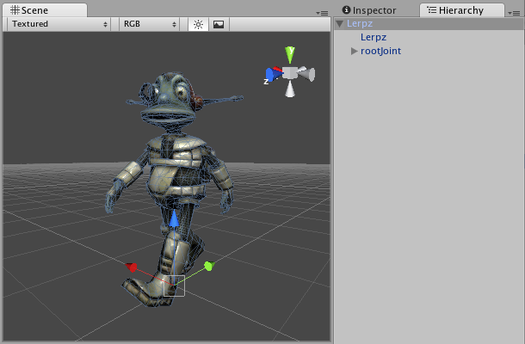
Objective
Learning Unity peaked my interests due to its relative ease of use while producing comparable results in terms of game quality
It also meant learning:
Object-Oriented Programming
Programming in C#
Some 3D Modelling
Piecing Together Scripts

Slide 5
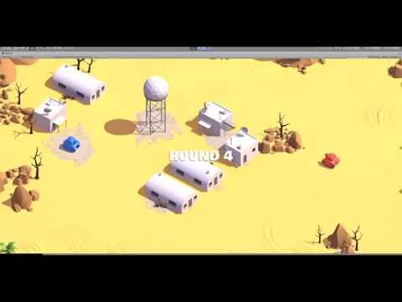
Project
I made a 2-player tank game, where the players fight each other on a local machine
The players control the tanks with one keyboard, and see everything on one screen
The objective is, of course, to eliminate the enemy
I followed a tutorial to begin with and built from there
There’s a clip on the right to show what the game is like, though much has been added since

Slide 6
Is the Fire Still Alive?
Yes, I am still interested and will continue learning and developing the game
Releasing a small game as a side project is a bit of a dream of mine, and my game is just that
The Unity platform allows all the resources and support I would need to continue my learning, so I will definitely continue into more difficult things, as I find this fascinating

Slide 7



Before
I knew I wanted to make a game as my 20 time, but a lot of ideas were bouncing around while I was looking for a good platform to build it with
Old ideas included:
Android game (anything simple)
Physics car simulation in JS
Flappy Bird Clone in JS
Unreal Engine 4 Project

Slide 8
During
The biggest question was “learn and create from scratch or use a tutorial?”
I decided to use a tutorial to ensure I don’t get lost and to get the basics taught to me
I tried making different games before I reached the one I made in the end, with lots of tutorials who were bad/slow/really boring
I then found one that was from Unity itself, and used it to guide me through starting my project

Slide 9
After
After lots of considerations and searching, I decided to go with the tank tutorial from Unity
It teaches the basics of everything and leaves you with a really good base game
After I finished the tutorial, with the information they taught me, I went on to make several more scenes (a main menu, settings, credits), and I am currently in the works of adding more maps

Slide 10
After
I did want to implement co-op capability over a network
I thought about making character customization
I also considered transferring this to the mobile unity engine and being able to export it into android SDK and then uploading it to the Google Play Store

Slide 11
Implementation
I began the project by closely following the guide, which taught me all the basics
From there, the changes I mentioned previously were made with the Unity interface and a little coding in C# (which I found some resources on)
The game is still under development, as customizations are made and the game is taking the form I have envisioned

Slide 12
Analysis
What Worked
I was successful at making a game and altering it
I was successful at learning how to use Unity at a base level (it is very complex, but I learned more than I thought I would)
I did learn a little about C#, and a little about working with 3D models in Unity’s environment
I learned all about how to piece lots of different scripts and gadgets together to make a project

Slide 13
Analysis
What Didn’t Work
I did not learn as much C# as I had hoped
I did not get to model in a 3D environment, though I did get to edit existing models and tweak with them
Things that I wanted to do but were too difficult:
Making this into an android game
Implementing network play
Character Customization
Creating my own custom music

Slide 14
Analysis
Overall
Due to the amount of creative freedom most realistic ideas I had I was able to implement
I have achieved my main goal of making a game and learning how to use Unity
I did not get to learn a lot of technical stuff but with more time as the project progresses I hope to
Overall I would say this project was fairly successful, and I certainly enjoyed making it

Slide 15

Where I Was
Started this project with no knowledge of using Unity or C#
I had changed my focus several times
I had no idea how to make games in 3D. At all.
I had no experience making actual games for windows (ones that run locally)
No idea how to implement CO-OP

Slide 16
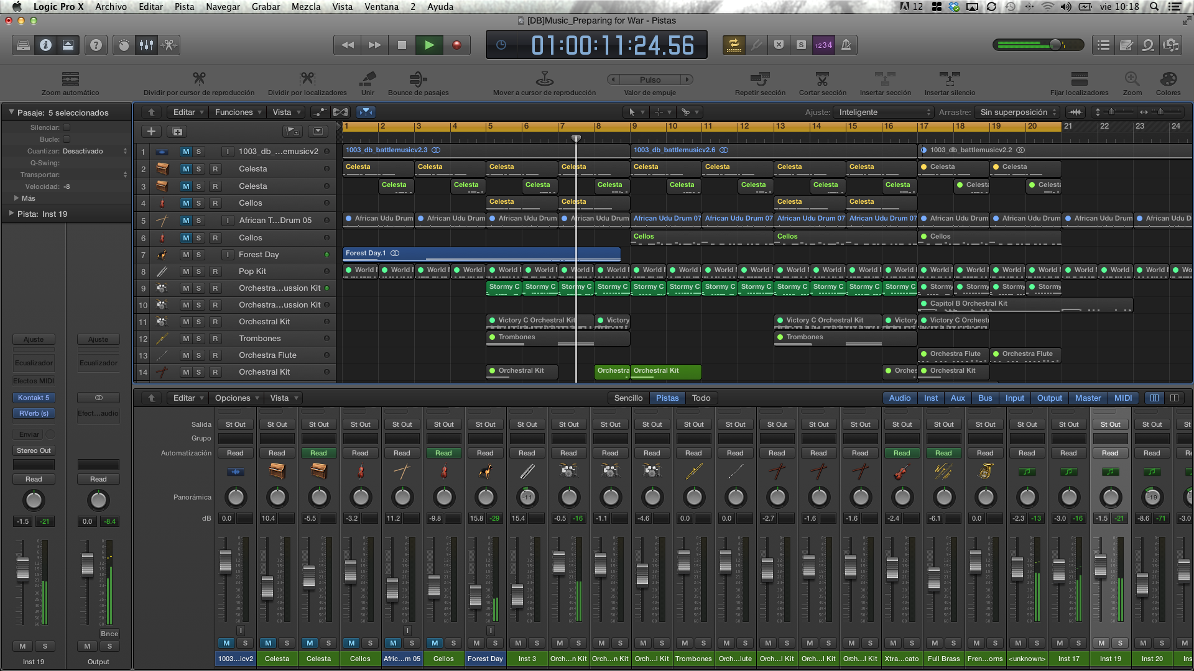
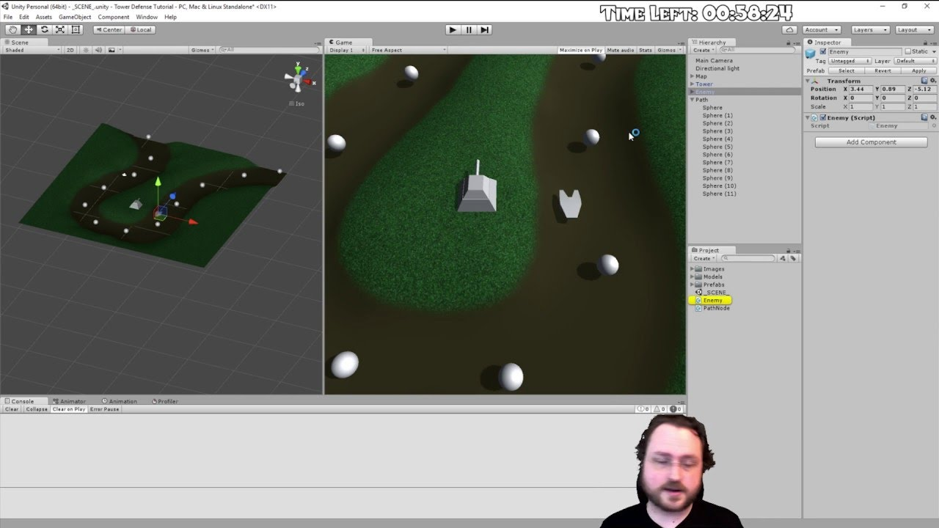
Where I Am
After making the project, I learned:
Manipulating variables to make settings menu
Manipulating variables to allow CO-OP
Making games in Unity engine
Combining scripts
Importing and producing game components
Etc, etc.

Slide 17
Where I'm Going
I plan to continue the project in the future
I have yet to learn how to 3D model for games, interested in that
This project got me interested in C# as a language to learn
Learning the Unity engine exposed me to other game engines such as Unreal, which I am also interested in trying

Slide 18
That’s all folks!

